Slide 1
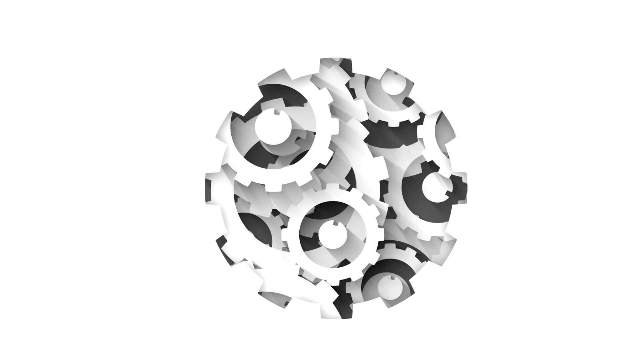
Workshop
By: Krishan, Isaiah, Jonathan

Slide 2
What is TAP?
TAP is a project-based class focused on:
Providing a collaborative environment for students
Working with classmates on a semester-long project
Allowing students to use technologies of their choice
TAP's goals include:
Increasing participation in IT
Organizing outreach activities and workshops
Showcasing the creative and fun side of technology

Slide 3
Goals
Target Audience:
Students of all ages
Purpose of the Study:
Teach students how basic image recognition works
Introduce students to the foundational concepts of AI
Motivation and Need:
Engage students in active learning
Promote interest in technology at an early age
Foster outreach and engagement in the field of AI

Slide 4
Project Description
Project Overview:
Students will design custom hand gestures or images to represent specific movements or commands for an MBot robot.
Key Technologies:
Image recognition
Machine learning
Objectives:
Train a model to recognize gestures and commands
Teach the robot to react accordingly (e.g., move forward, turn, stop, navigate obstacles)
Skills Developed:
Image recognition
AI model training
Robotics control
Learning Experience:
Hands-on project to explore the complexities of creating real-world applications
Engage with AI and robotics technologies while tackling real-world challenges

Slide 5
Workshop Description
What you will be doing:
Students will be learning what CNNs are and how CNNs function at a high level.
Students will train their very own computer vision model with symbols and gestures of their choice.
Students will use the trained model to attempt to navigate an obstacle course.

Slide 6
Pre-trained Model:
Open the MBlock file
Connect your Mbot MegaPi
Control your Mbot with our pre-trained model that uses shapes to control the Mbot !
(This model cannot be edited, any changes wanted to be made will require creating a new model)

Slide 7
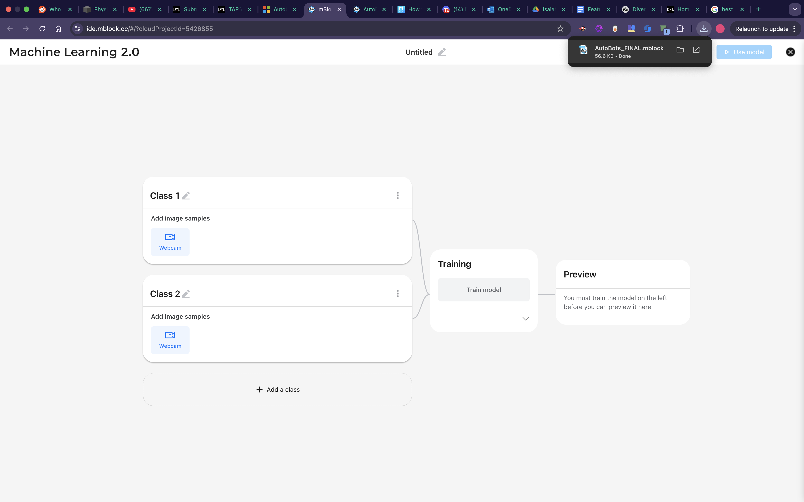
Train Your Own Model:
Begin by opening the MBlock file and navigating to the module labeled "Machine Learning"
Click the "Create/Manage Model" button, from there you will be taken to Google's Teachable Machine.
Click "New Project" under "Image Project" and name your model whatever you want!
You will be taken to this page: (See right)

Slide 8
Train Your Own Model:
5. Create up to 4 classes with unique names.
6. Prepare your very own symbols or hand gestures (remember to make them as different as possible!)
7. Go and take your training images for each class and then train your model.
8. After the training is complete select "Use this model" in the upper right corner
9. Go through each instance where there are green blocks and make sure you switch the model and class for each!
10. Control you Mbot with your custom symbols/gestures !

Slide 9
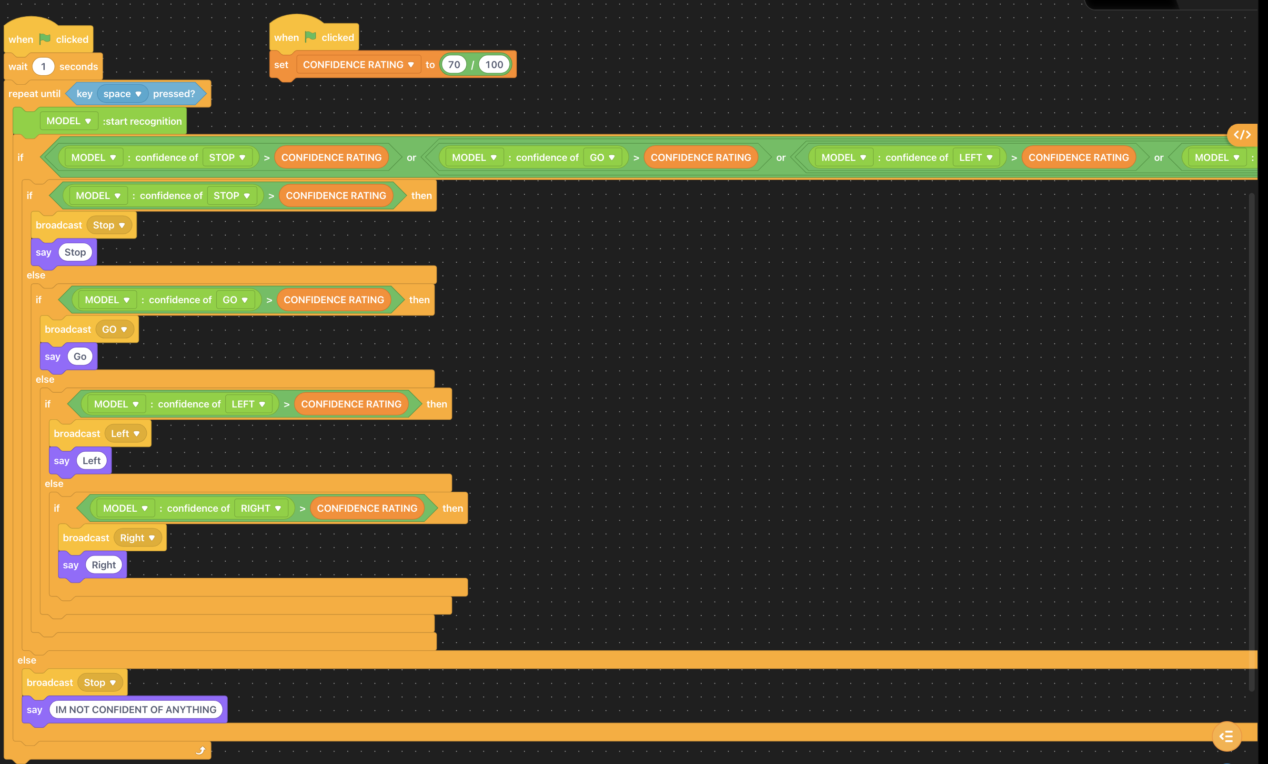

Train Your Own Model:
Make sure you change both the model and the class for every instance they are mentioned!

Slide 10
Results
Document 3.docx (Survey will turn into QR Code during workshop)

Slide 11
Questions?

Slide 12
Thank you!

